Slide 1



Slide 2
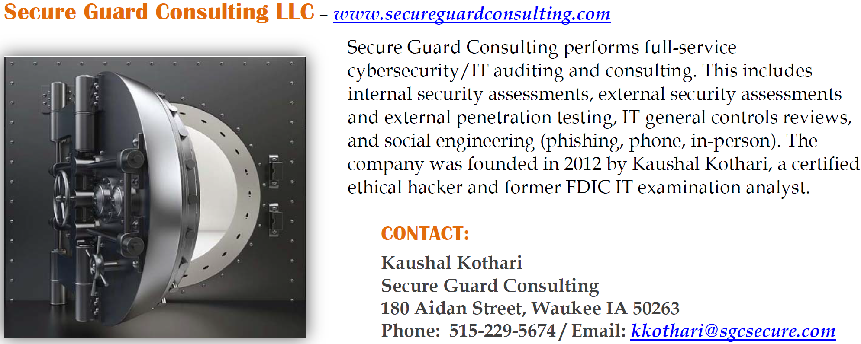
About Secure Guard Consulting

Slide 3
Securing Microsoft 365

Slide 4
Licensing
Business standard (not sure the exact name) – gets you the basic “security defaults”. You can manage access to OWA individually, but it’s unclear for how long that will be available.
Business premium – lets you go beyond “security defaults” and control authentication and access better through conditional access policies.
Adding P2 – gives you the ability to build conditional access policies to handle risky user behavior and risky sign-ins.
E5 - everything Microsoft has to offer

Slide 5
Minimum – Business Premium

Slide 6
Licensing gaps
Technically, you can have every user in the bank on business standard and one license for business premium and get conditional access capability.
Similarly you can be business premium and do P2 licensing on one account and get risky sign-in abilities
Both would be NOT compliant with Microsoft licensing terms and a Microsoft audit could cause issues.
We don’t recommend rolling the dice on this. Anecdotally, we’ve heard of at least one situation where the MSP itself was penalized
  Loss of partner benefits for the MSP
  Risk of License true-ups (being forced to purchase licenses retroactively)

Slide 7
Attack vectors

Slide 8
Attack vectors
Traditional attack vector
  Credential harvesting – send a phish with a link to a page where it asks for credentials then use those credentials to log into M365.
Password spraying
  Take one, two, or however many common passwords (e.g., Winter2024!) and try them on all accounts.
    Hackers can get accounts from tools like Harvester (Kali) or others like hunter.io, the bank’s website, or going through LinkedIn – once the pattern of an email address is known, that’s all that’s needed is first name and last name.
MFA Bypass (e.g., Evilginx)
  Similarities to credential harvesting, but instead of just capturing credentials, the purpose is to proxy those to the authentication mechanism.
    Except that tools like evilginx will also present prompts to capture MFA tokens and ultimately sessions.

Slide 9
MFA Bypass
Demo from SGC - https://youtu.be/ojk3xTh_fOI
  Or go to secureguardconsulting.com, hover over webinars … and choose videos, then click link to “M365 MitM / AitM MFA Bypass Attack”
Basics though – are hackers get a server (e.g., droplet on digital ocean), install evilginx (different versions available), attach a domain, create the phish (in evilginx’s case, their called lures), then send out the phish.
  Victim enters username + password → Evilginx proxies to real site.
  Real site triggers MFA → Evilginx proxies the challenge (push, SMS, etc.).
  Victim completes MFA → Real site issues session token.
  Evilginx steals the session token, not just credentials.
  Attacker uses token to log in without needing MFA or password.

Slide 10
Attack vectors
Once username and password are obtained, open a mobile phone and log in or user-agent spoofing.
  Open Chrome.Press F12 or Right-click > Inspect to open DevTools.
  Click the three dots in the DevTools pane (top-right) → go to More tools > Network conditions.
  In the Network conditions tab:Uncheck "Use browser default" under "User agent".Select a preset like "Chrome — Android Mobile", "Safari — iPhone", or custom.
  Legitimately used for things like testing site accessibility (as an example)
Simply open Outlook or some email utility on a desktop or laptop and add an account.
Graph API via PowerShell or other services - Exchange Online (Connect-ExchangeOnline), AzureADAzure AD (MSOnline) (Connect-MsolService), MSOnlineMicrosoft Graph (SDK) (Connect-MgGraph) are some examples.

Slide 11
Our Recommendation
Establish trusted IPs (external facing IPs of the bank and of the MSP).
Block all M365 services outside of those trusted IPs unless
  they are on a managed and controlled devices and
  have MFA implemented for initial access
Do NOT allow any OWA capability outside of trusted IPs
I have tested this with Evilginx
  if you are allowing access within a trusted IP, but blocking it outside of those trusted IPs, then the Evilginx MFA bypass, as it stands today, won’t work. Ultimately, it’s trying to authenticate from outside of trusted IPs.

Slide 12
NeW
Phishing resistant MFA – I don’t have much experience with this, but I have tested with a customer who is using this, and Evilginx type attacks do NOT work when using phishing resistant MFA.
  I think this is the future and it can be via the Microsoft Authenticator app.
  Essentially it ties authentication to the device itself.
There is an option under sessions now as well (within CA)
  Require token protection for sign-in sessions (Preview)
Once we understand more on how this works, we’ll relay information out.
***** Ultimately though, with how quickly attacks evolve, why take a chance? Move to one or both of the above and still limit access outside of trusted IPs. *****

Slide 13
Building off the email
For Global Admin Accounts
  (High) Implement IP restriction for access to global admin access to Microsoft 365 (e.g., network support vendor trusted IPs and the bank’s trusted IPs).
  (Medium) Configure session limits for global admins to 4 hours or less.
  (Medium) For global admin accounts, disable persistent browser sessions.

Slide 14
Glass Break accounts
Different views on glass break accounts
For some, a glass break account would be a full global admin and only username and password stored somewhere secure, excluded from all conditional access policies, and ideally changed each time its used.
  Our recommendation in this case is to ensure (and test) that there's an alert each time that account is accessed in any way, and then ensure it’s changed as needed.
One step that could be taken is to create a policy to limit the above to trusted IPs.
Our preference would be that the glass break account has MFA.

Slide 15
M365 Oversight
EVERY bank should be looking to get some form of Microsoft 365 oversight.
  SIEM or similar too to capture logs and alert or take actions as necessary.
  For example alerting
    Anytime a conditional access policy or security setting is change (common mistake that can lead to breaches)
    All new device enrollments (mobile device)
    Indicators of MFA bypass attacks
    If forwarding is allowed, then alerts when forwarding to external domains is done
    Access to a glass break account
  These are just some examples, but the above should be at a minimum, especially alerts on changes to conditional access policies.

